Slide 1
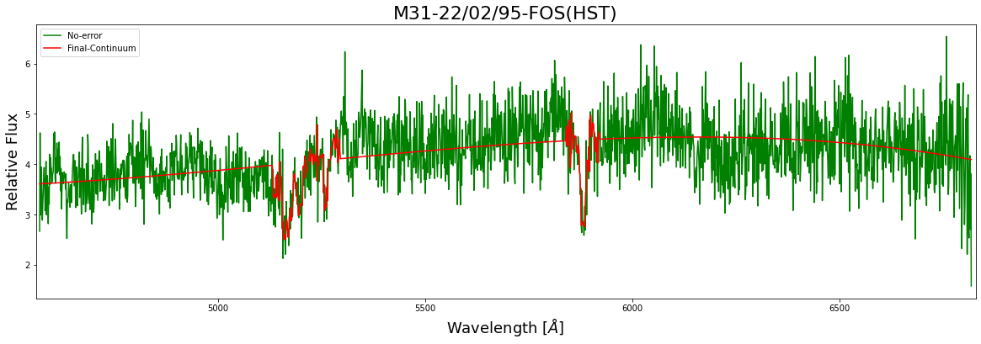
M31 Spectra Analysis
Vampy
Notes:
Have to write script
<number>

Slide 2
Why care about Spectra?

Slide 3
It’s the only thing we have in most cases!

Slide 4
Spectra can tell us about...
Type of the object
Contents of the object
Motion of the object
How active the is region around the object

Slide 5


What is Project about?
Spectral Data from the central region of M31 was analyzed and fitted
Absorption Lines were also identified
SciPy suite and AstroPy were used for reduction and analysis of the data
Notes:
<number>

Slide 6
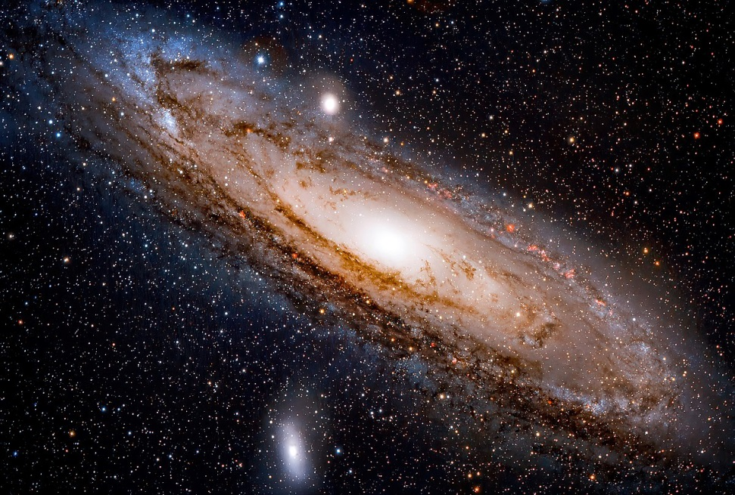
What is M31?
Type: Spiral Galaxy(Sab)
Distance from Earth: 2.53Mly
Age: 10.01 Byr

Slide 7
Where is the Data from?

Slide 8
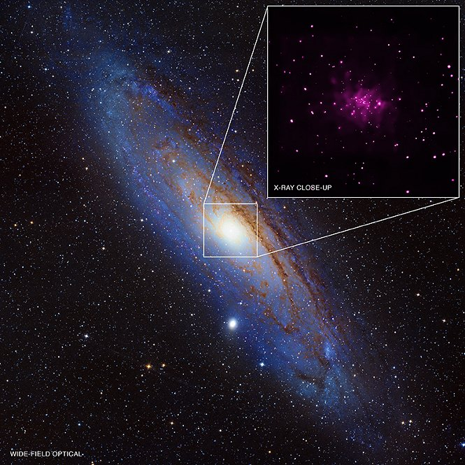
Location: Galactic Center of Andromeda

Slide 9
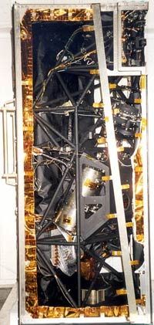
About the Data-set
Instrument: FOS(HST)
Wavelength: 4569.102 Å-6817.517Å
Date-OBS: 22/02/95

Slide 10
What do we expect Galactic Spectra to look like?

Slide 11
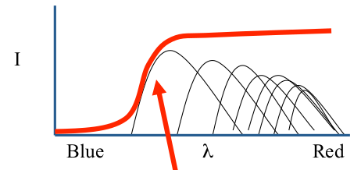
Galactic Spectra
4000Å break

Slide 12
Why we expect 4000Å break?
Lack of Hot blue Stars because they are short lived
In metal rich region higher energy light is absorbed by the metals

Slide 13
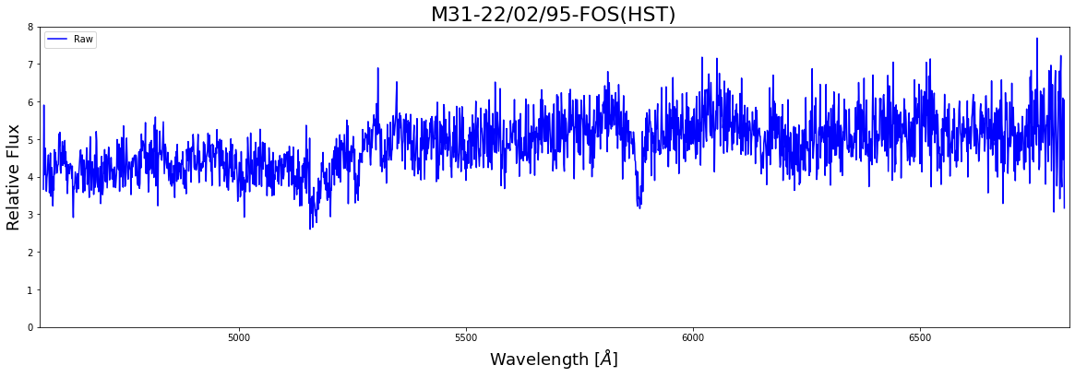
What does the raw data looks like?

Slide 14
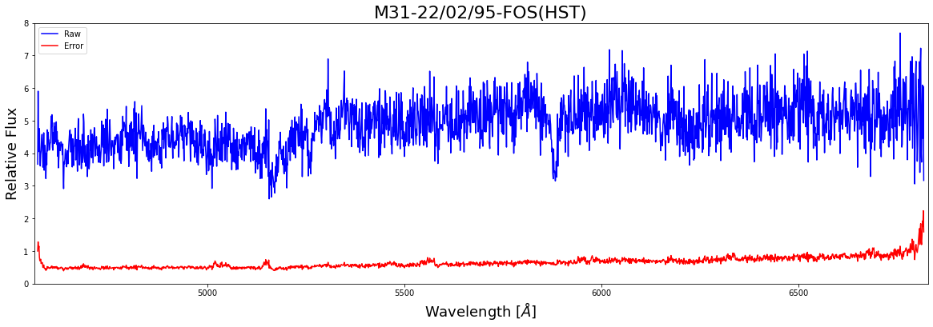
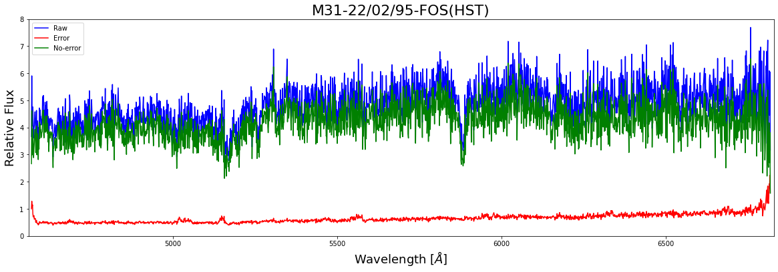
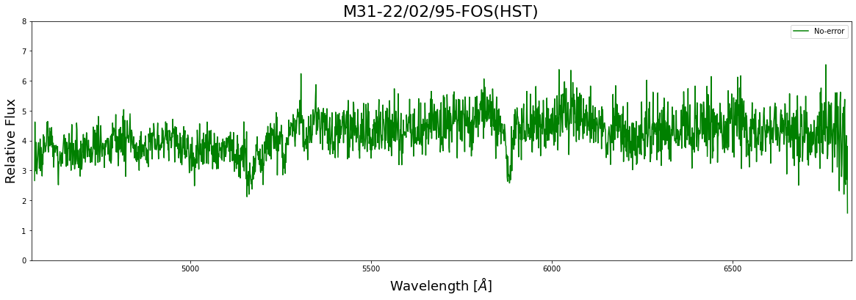
Removing the Error

Slide 15
Raw Data
No Error

Slide 16
Spectrum Fitting Process

Slide 17

Continuum Fit

Slide 18
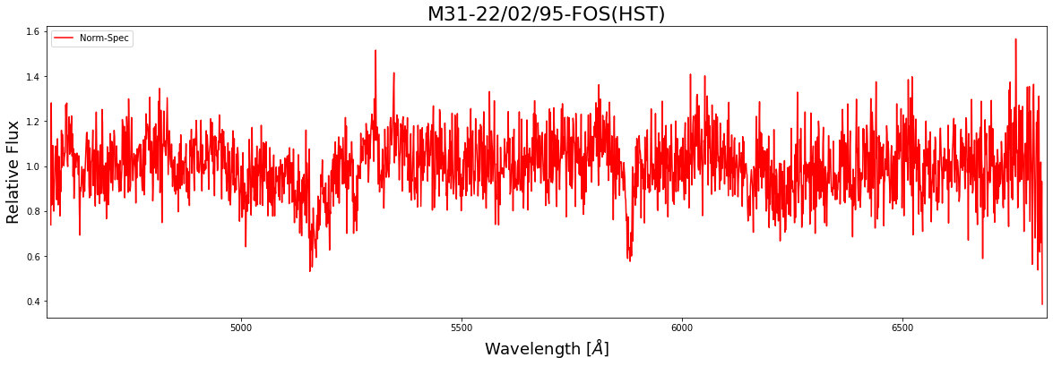
Normalized Spectra

Slide 19
Identifying and Modeling the Spectral lines

Slide 20
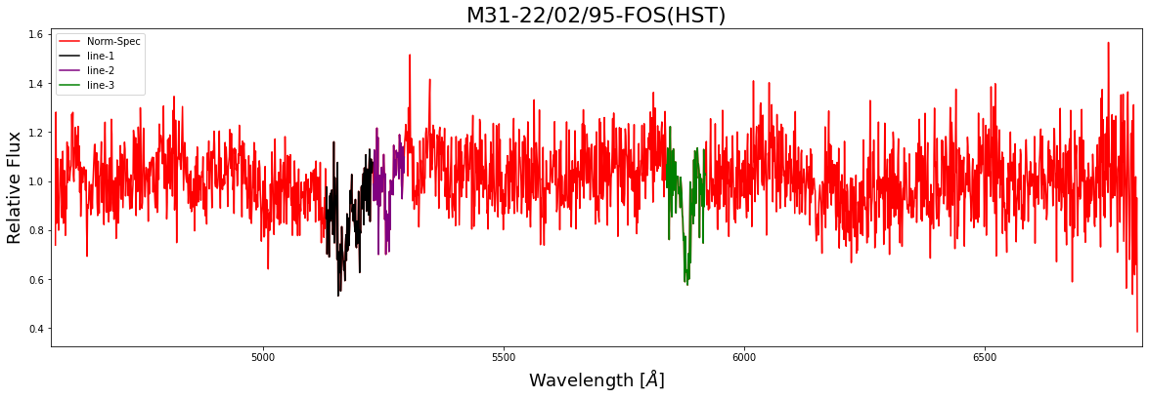
Identification of Absorption lines
Identification was done manually

Slide 21
Why was identification done manually?

Slide 22
Typical Spectral Feautures
Absorbtion lines
Ca[H] = 3933.7Å
Ca[K] = 3968.5Å
G-band = 4304.4Å
Mg[I] = 5175.3Å
Fe[I] = 5270.3Å
Na[I] = 5894.0Å
Emission lines
O[II] =3727.3Å
Hδ = 4102.8Å
Hɣ = 4340.0Å
Hβ = 4861.3Å
O[III] = 5006.8Å
Hα = 6562.8Å
S2 = 6716.0Å

Slide 23
Mg I
Fe I
Na I

Slide 24
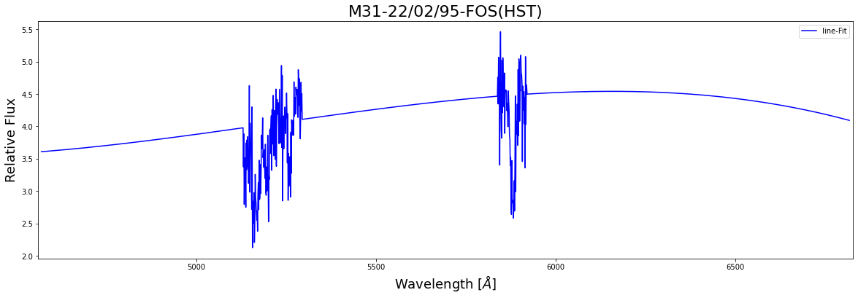
How was Line Fitting done?
Absorption lines were Superimposed on the continuum fit

Slide 25
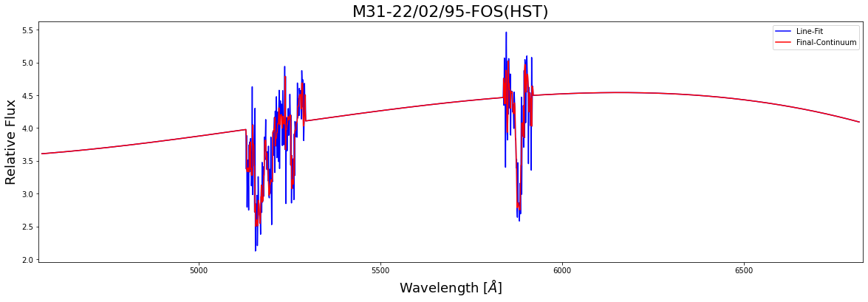
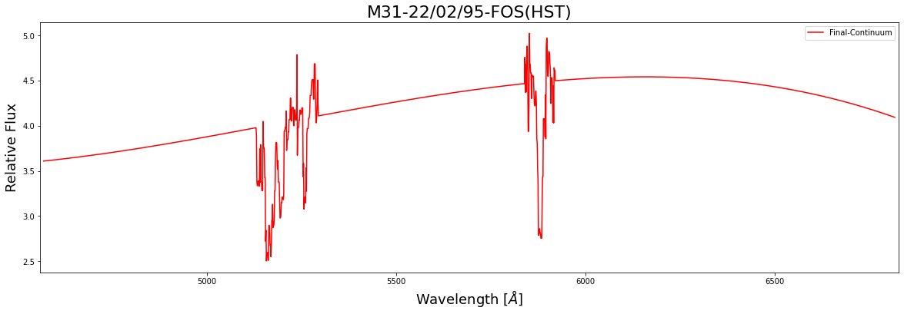
Smoothing of the Continuum
The Spectra was passed through 1D-median-filter to smooth it out

Slide 26
Comparison of Final Continuum with the Original Spectra

Slide 28
Original Spectra
Final Continuum

Slide 29
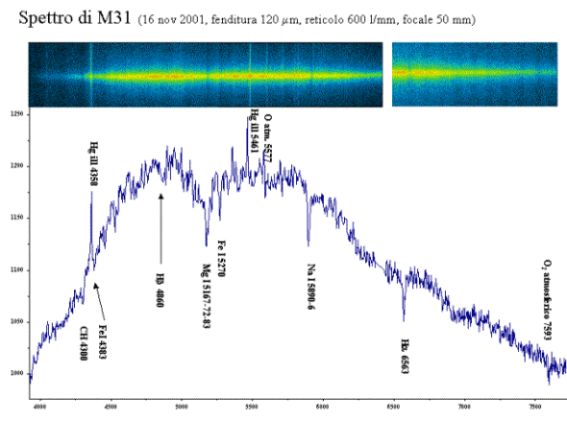

Slide 30
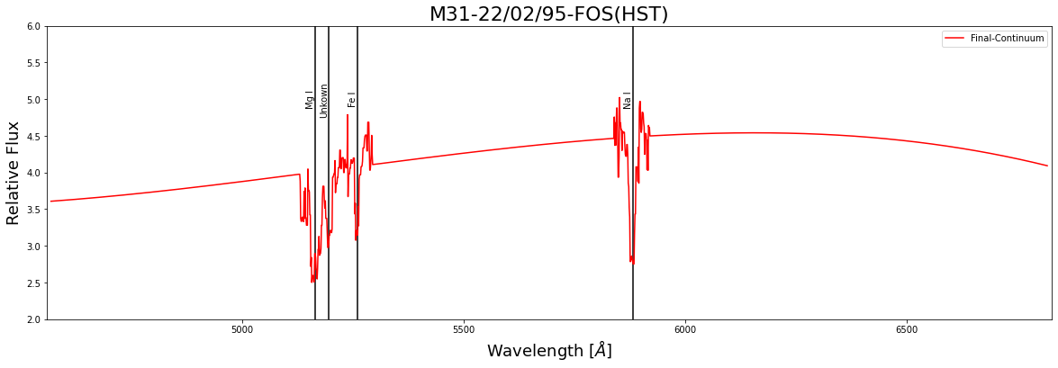
Spectral Lines
4 Absorption lines were found
3 lines were expected!!
Notes:
3 absorbtion lines were associated
<number>

Slide 31
Why is the 4th line present?
Could be due to fluctuation in the instrument
Could be due the process used for fitting
Could be a Random error

Slide 32
Deduction from the Analysis

Slide 33
Element finding
3 elements were identified in the region
Mg I[5165Å]
Fe I[5261Å]
Na I[5881Å]

Slide 34
Properties of the region
Old and red stars are present in the region because no emission lines were found
Qualitative overview of the Spectra suggest that Popullation II stars are present in the region
No evidence Hα was present. This implies no active star formation is going on in the region

Slide 35
How can the process be improved?

Slide 36
Gaussian modelling
We can model the absoption lines as a ‘Gaussian Distribution’ becuase the broadening of the line is due to ‘Thermal Doppler’, meaning that the thermal jittering of molecules is producing the ‘Line Broadening’ effect
This implies that the brodening will follow ‘Central Limit Theorem’, thus the distribution will be a Gaussian

Slide 37
What can further be done with the results?
We can use the concept of ‘Thermal Doppler’ to get the Gas temperature and Velocity distribution of the region
Redshift can be calculated which can be further used to get radial velocity of the Galaxy
If the inclination of the Galaxy is known we can get the motion of the Galaxy

Slide 38
Further results coming soon :)

Slide 39

Thank You

